Slide 1
Object Detection for Self Driving Cars using Yolo algorithm
A.Dileep.
Data Science

Slide 2
Introduction
Self-driving systems are commonly categorized into three subsystems: perception, planning, and control. In this project, the perception problem is studied in the context of real-time object detection for autonomous vehicles.
The planning system makes purposeful decisions based on the environment model, and the control system executes planned actions. The objective of this project is to study the perception problem in the context of real-time object detection for autonomous vehicles.

Slide 3
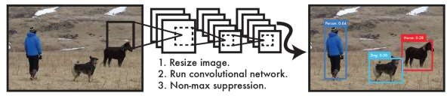
Proposed system
CNN(YOLO) : Object Detection as Regression Problem.
output: Bounding box coordinates and Class Probabilities
Single Neural Network
Benefits:
Extremely Fast (one NN + 45 frames per sec), twice more mAP.
Global Reasoning (knows context, less background errors)
Generalizable Representations (train natural images, test art-work
, applicable new domain

Slide 4
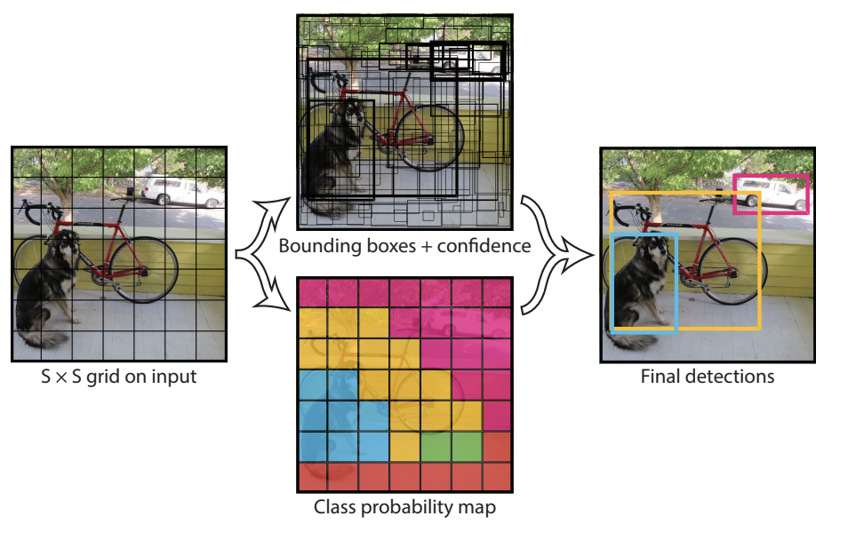
Detection Process (YOLO)
These predictions are encoded
as Tensor of dimension
(SxSx(Bx5+C))
SxS grid,
C = class probability,
B= no of bounding boxes

Slide 5
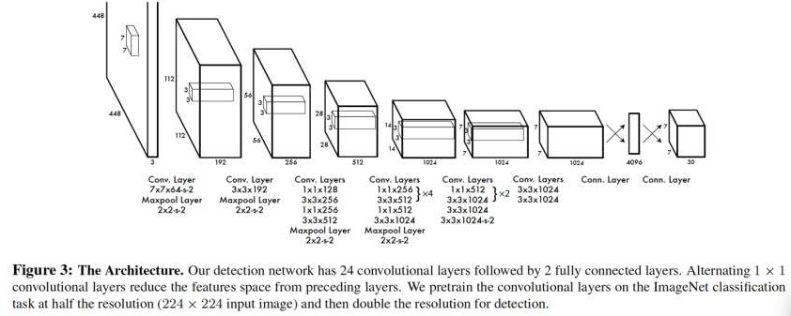
Network Design
Inspired by the GoogLeNet (image classification)
24 convolutional layers followed by 2 fully connected layers
Fast YOLO uses 9 convolutional layers (instead of 24)

Slide 6
Implementation
With YOLO, a single CNN simultaneously predicts multiple bounding boxes and class probabilities for those boxes. YOLO trains on full images and directly optimizes detection performance. This model has a number of benefits over other object detection methods: YOLO is extremely fast.
YOLO is popular because it achieves high accuracy while also being able to run in real-time. The algorithm “only looks once” at the image in the sense that it requires only one forward propagation pass through the neural network to make predictions.

Slide 7
Limitations of YOLO
Struggle with small objects
Struggles with difference aspects and ratio of objects
Loss function treats error in different size of boxes same.

Slide 8
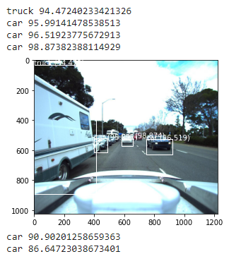
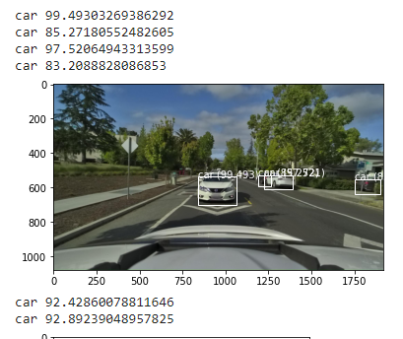
Results

Slide 9
Conclusion
YOLO is fast. When lives are on the line, autonomous can’t spare an extra second to make decisions. Deep learning, Computer vision and other object detection algorithms got the job done. In some cases were even more accurate than YOLO, but they were much slower. This made people hesitant to use AI for autonomous tasks. Now algorithms can make decisions in real-time.
The human eye can detect and processes objects in 13 milliseconds, but with YOLO we’re able to detect even faster, potentially helping reduce the over 1 million deaths from car accidents.

Slide 10
References
https://medium.datadriveninvestor.com/how-self-driving-cars-see-deeb87cac531.
https://towardsdatascience.com/real-time-object-detection-with-yolo-9dc039a2596b.

